Slide 1
Fundamentals of Cloud Computing

Slide 2
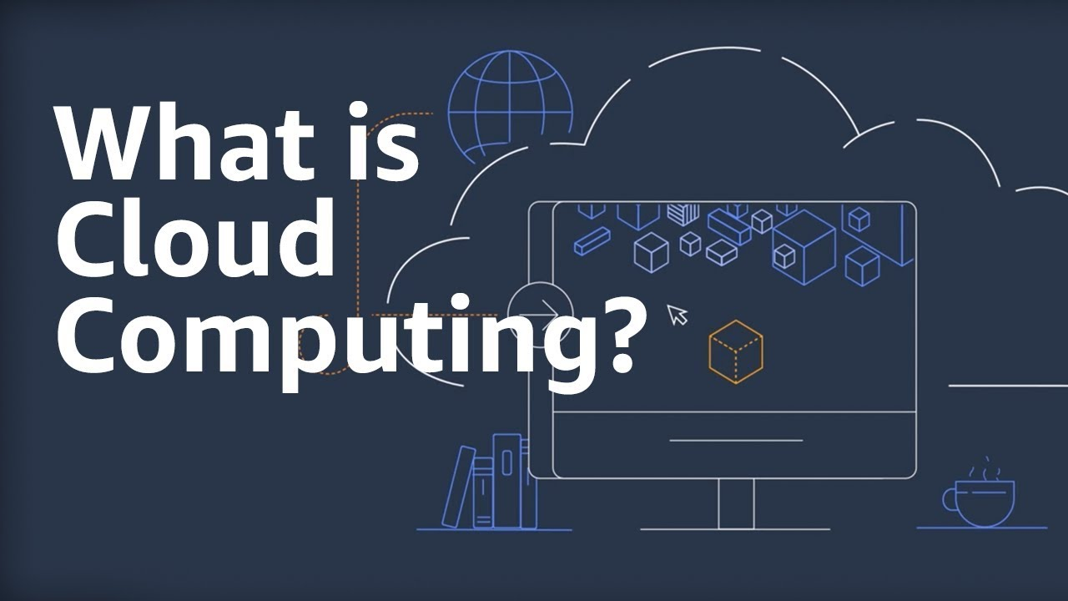

Slide 3

Cloud Computing
On-demand delivery of compute, database, storage, application and other IT resources through a cloud service platform via internet with pay-as-you-go pricing
Advantages of cloud computing
1. No Capital Investment

Slide 4
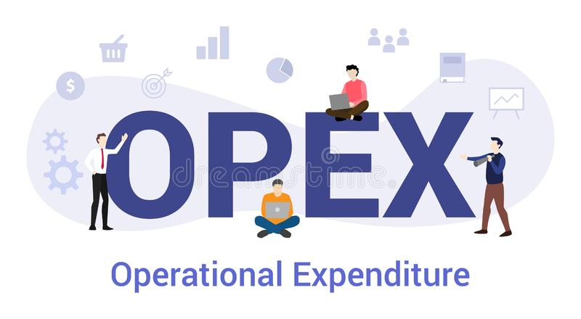

2. Only Operational costs with pay-as-go prices
3. Flexibility in Capacity

Slide 5


4. Speed and Agility
5. Users can concentrate more on their core business processes with no Datacenter maintenance

Slide 6
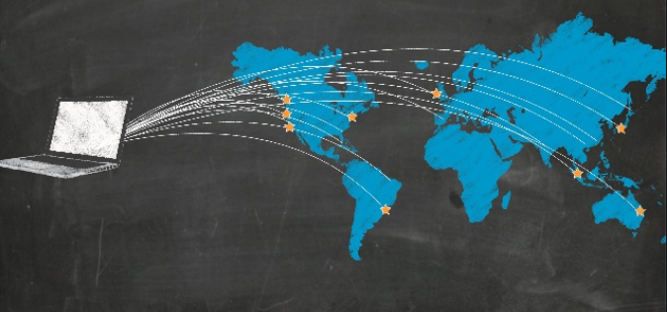
6. Go Global in Minutes

Slide 7
Virtualization
It is the process of creating virtual format of resources like hardware, software, etc.
Virtualization is nothing but a software layer that creates in between Virtual and host machine.
Uses/Benefits
Greater importance in cloud computing
Cloud Service providers are able to create virtual machines in cloud computing. The applications are deployed in virtual machines so that it can be accessed from anywhere in the world in its virtualized form.
The VM image is created, and when a user sends request for accessing a particular resource, the VM instance is created and access is provided.
The advantage of virtualization is that the CPU is shared among different OS.
Multiplexing hardware resources to many OS is done by Virtualization Layer
Reduced capital and operating costs.

Slide 8
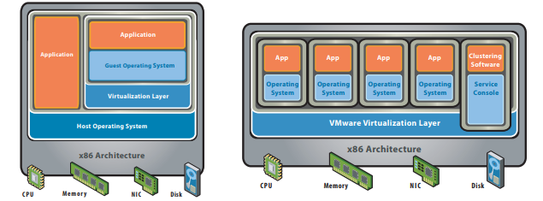
Hosted and Bare-metal architecture
Hosted Architecture Bare-Metal (Hypervisor) Architecture

Slide 9
Types of Cloud Computing
Cloud computing is usually described in one of two ways. Either based on the deployment model, or on the service that the cloud is offering.
Based on Service models, we are speaking of either
Infrastructure-as-a-service (IaaS)
Platform-as-a-service (PaaS)
Software-as-a-service (SaaS)

Slide 10
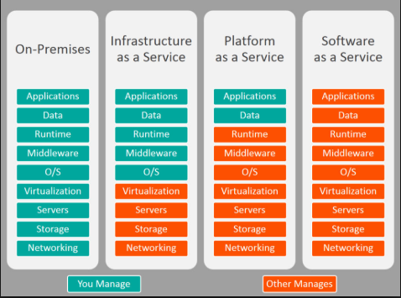
Comparison for IaaS, PaaS, SaaS

Slide 11
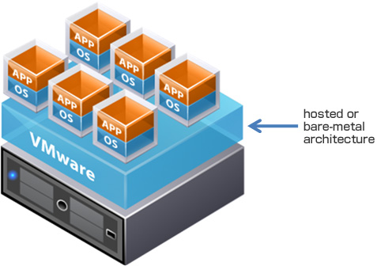
Based on Deployment models, we have
Public Cloud
Private Cloud
Hybrid Cloud
Public Cloud
Public cloud usually uses shared resources and it also means, if all parts of the application run in the cloud which built on low-level infrastructure prices.

Slide 12

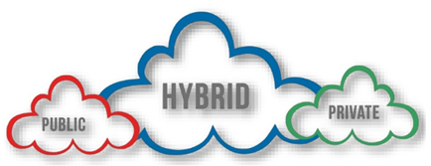
Private Cloud
The deployment of resources on-premises, using virtualization and resource management tools, is sometimes called the “private cloud”. It also means using a cloud infrastructure (network) solely by one customer/organization.
Hybrid Cloud
A hybrid deployment is a way to connect infrastructure and applications between cloud-based resources and existing resources that are not located in the cloud.

Slide 13


